Slide 1
Java Swing
Università di Modena e Reggio Emilia
Prof. Nicola Bicocchi (nicola.bicocchi@unimore.it)

Slide 2
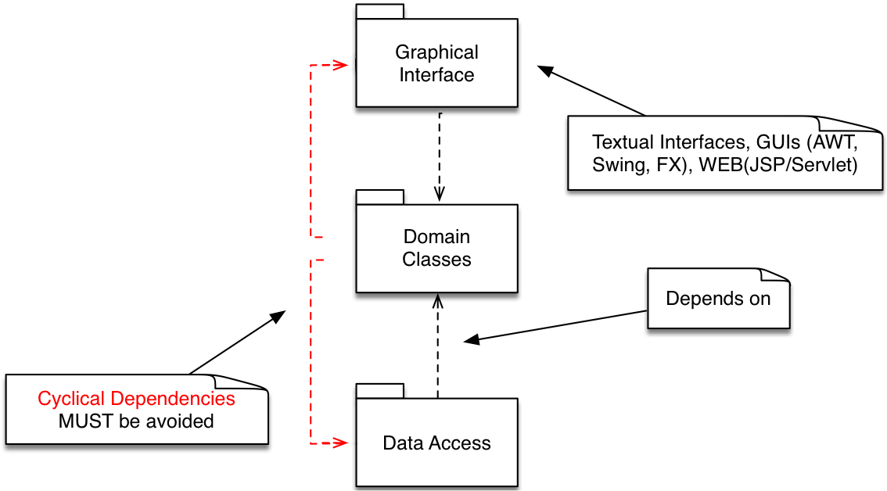
Software Design

Slide 3
Package java.awt.*
Provides:
Components (button, checkbox, scrollbar, etc.)
Containers (they are still components)
Event management
Layout management

Slide 4
Package javax.swing.*
Contains the same components of java.awt, but with different names (JButton, JFrame, etc.)
All these components derive from JComponent
Advantages:
provides a series of components with the same appearance and behavior on all platforms
look and feel changeable at runtime
Swing is an extension of AWT

Slide 5
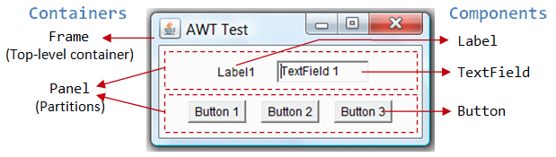
Containers and components

Slide 6
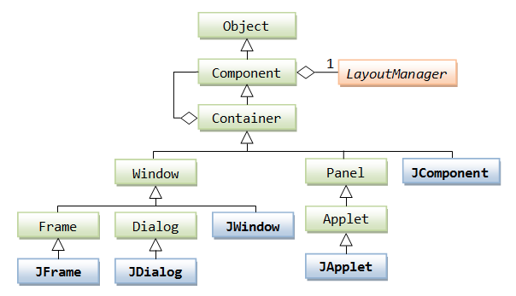
Class hierarchy (Containers)

Slide 7
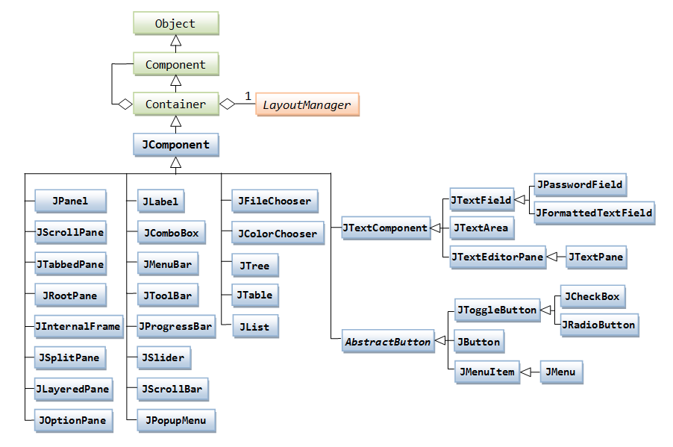
Class hierarchy (Components)

Slide 8
Graphical Programming
Set a Look & Feel (= Style)
Microsoft Windows, Mac, Java Metal
Define one (or more) top-level container
JFrame, JDialog
Add components to the containers
JButton, JComboBox, JSlider, …
Add secondary containers
Set Look & Feel
Define top-level container
Add component
Add secondary container

Slide 9
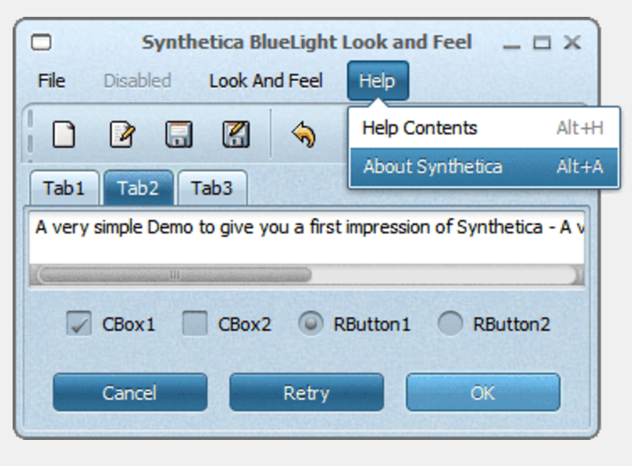
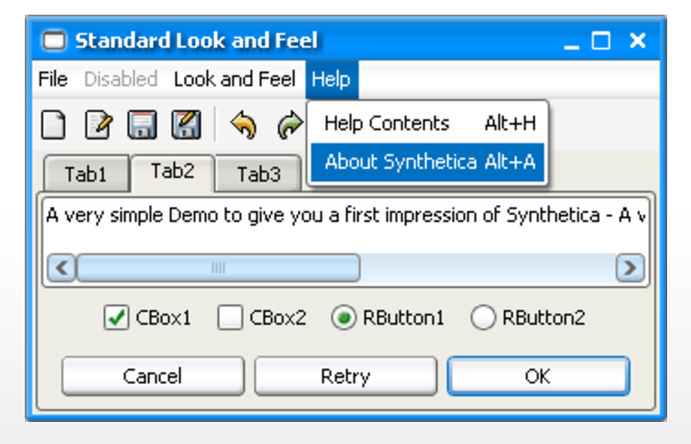
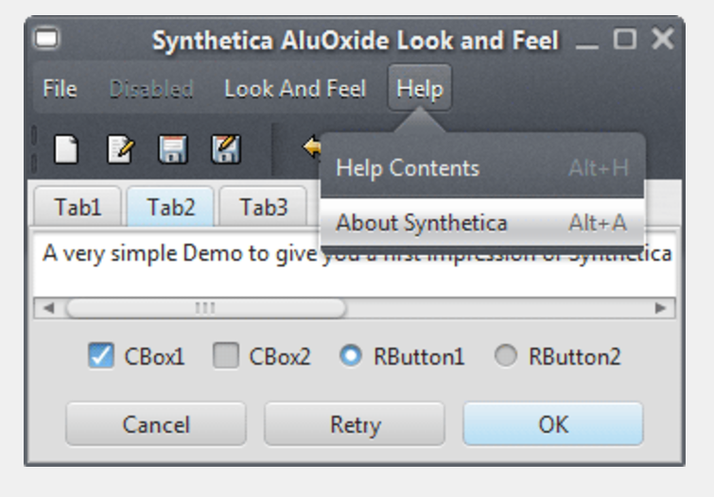
Look & Feel

Slide 10
Look & Feel
UIManager manages the current look and feel
http://www.jyloo.com/synthetica/themes/
/* Set Metal Look and Feel */
UIManager.setLookAndFeel("javax.swing.plaf.metal.MetalLookAndFeel");
/* Set Motif Look and Feel */
UIManager.setLookAndFeel("com.sun.java.swing.plaf.motif.MotifLookAndFeel");
/* Set Windows Look and Feel */
UIManager.setLookAndFeel("com.sun.java.swing.plaf.windows.WIndowsLookAndFeel");

Slide 11

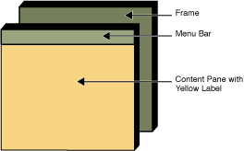
Top-level container: JFrame

Slide 12
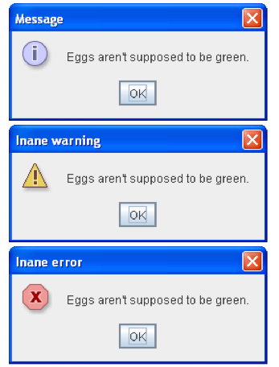
Top-level container: JDialog

Slide 13
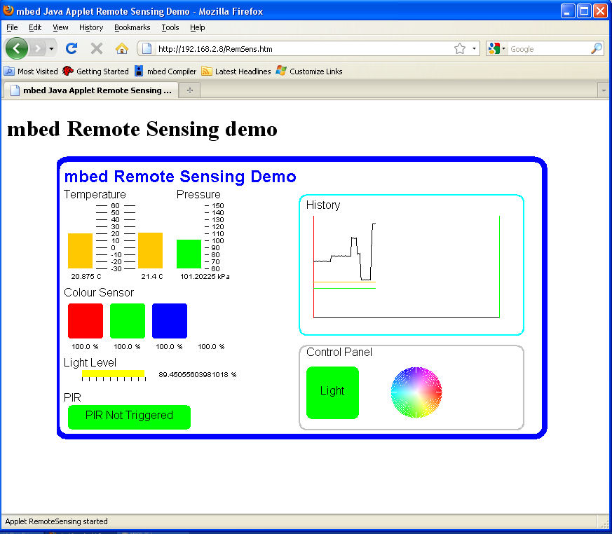
Top-level container: JApplet (deprecated)

Slide 14
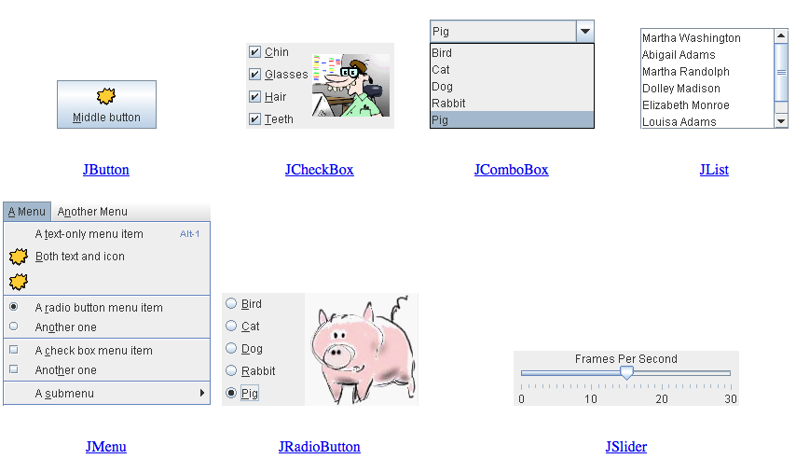
Components, a visual guide
http://web.mit.edu/6.005/www/sp14/psets/ps4/java-6-tutorial/components.html

Slide 15
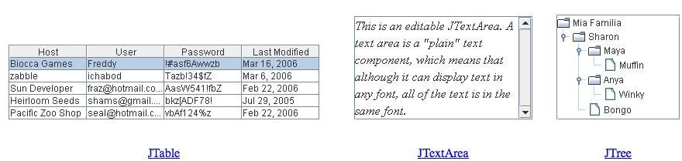

Components, a visual guide
http://web.mit.edu/6.005/www/sp14/psets/ps4/java-6-tutorial/components.html

Slide 16
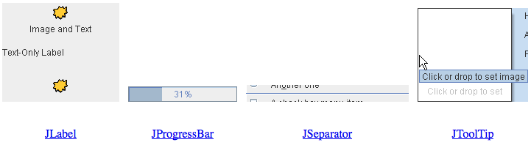
Components, a visual guide
http://web.mit.edu/6.005/www/sp14/psets/ps4/java-6-tutorial/components.html

Slide 17
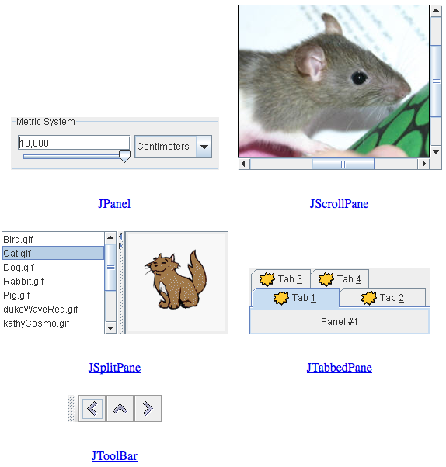
Components, a visual guide
http://web.mit.edu/6.005/www/sp14/psets/ps4/java-6-tutorial/components.html

Slide 18
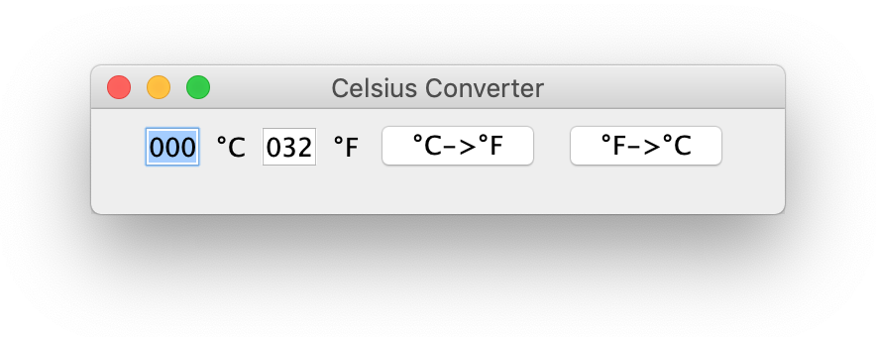
A complete example
public class CelsiusConverterBareMinimum extends JFrame {
private JButton CFButton, FCButton;
private JTextField fahrenheitTF, celsiusTF;
public CelsiusConverterBareMinimum() {
super("Celsius Converter");
celsiusTF = new JTextField("000");
fahrenheitTF = new JTextField("032");
CFButton = new JButton("°C->°F");
FCButton = new JButton("°F->°C");
JPanel p1 = new JPanel();
p1.add(celsiusTF);
p1.add(new JLabel("°C"));
p1.add(fahrenheitTF);
p1.add(new JLabel("°F"));
p1.add(CFButton);
p1.add(FCButton);
setContentPane(p1);
setDefaultCloseOperation(WindowConstants.EXIT_ON_CLOSE);
setSize(350, 75);
setVisible(true);
}
}

Slide 19
JFrame basic methods
getContentPane()
retrieves the primary JPanel
setContentPane(Container c)
sets the primary JPanel
add(Component c)
add a component to the primary JPanel
setDefaultCloseOperation(WindowConstants)
EXIT_ON_CLOSE
DO_NOTHING_ON_CLOSE
DISPOSE_ON_CLOSE
HIDE_ON_CLOSE
setSize(int base, int height)
defines the dimensions of the component
setVisible(boolean visibility)
defines the visibility status of the component

Slide 20
Running it!
// Ok
public static void main(String[] args) {
new CelsiusConverter();
}
// Better
public static void main(String[] args) {
EventQueue.invokeLater(new Runnable() {
@Override
public void run() {
new CelsiusConverter();
}
});
}

Slide 21
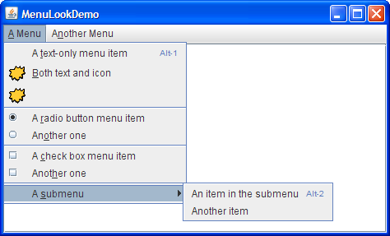
JFrame MenuBar
JMenu
JMenuBar
JMenuItem

Slide 22
JFrame MenuBar
In composing menus, three components are hierarchically involved: JMenuBar, JMenu, JMenuItem
JMenuItem openFile = new JMenuItem("Open");
JMenuItem closeFile = new JMenuItem("Close");
JMenu file = new JMenu("File");
file.add(openFile);
file.add(closeFile);
JMenuBar menuBar = new JMenuBar();
menuBar.add(file)
setJMenuBar(menuBar);

Slide 23
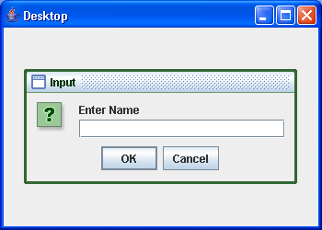
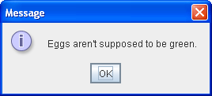
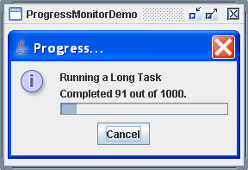
JDialog
Applications need to provide information, feedback and advise to their users!

Slide 24
JDialog
Dialogs are a better choice than instantiating multiple JFrames!
Every dialog is dependent on a top-level container.
Dialogs are all instances of JDialog, and can be generally composed following the same guidelines seen for JFrames. Nevertheless, the majority is built automatically using helper classes (e.g., JOptionPane).

Slide 25
How to make Dialogs
Specializing JDialog (top-level container) and defining your own layouts. Same principle as specializing JFrame.
Using JOptionPane. JOptionPane provides support for laying out standard dialogs with icons, buttons, title and text.

Slide 26
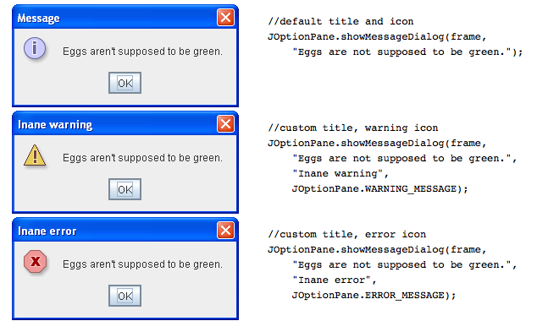
JOptionPane.showMessageDialog()

Slide 27
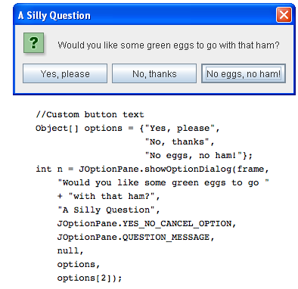
JOptionPane.showOptionDialog()
Displays a modal dialog with the specified buttons, icons, message, title, and so on. With this method, you can change the text that appears on the buttons of standard dialogs. You can also perform many other kinds of customization.

Slide 28
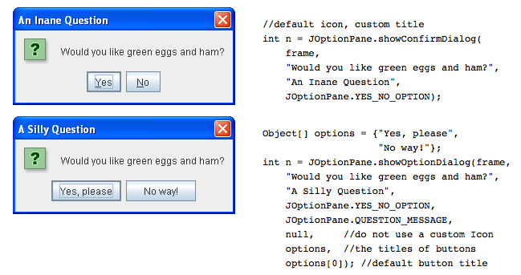
JOptionPane.showConfirmationDialog()

Slide 29
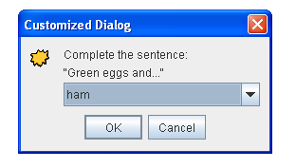
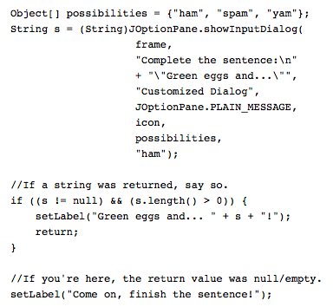
JOptionPane.showInputDialog()

Slide 30
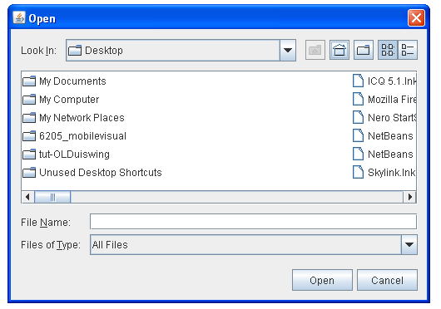
JFileChooser
Provides a GUI for navigating the file system
JFileChooser open = new JFileChooser();
int option = open.showOpenDialog(this);
if (option == JFileChooser.APPROVE_OPTION) {
/* do stuff */
}

Slide 31
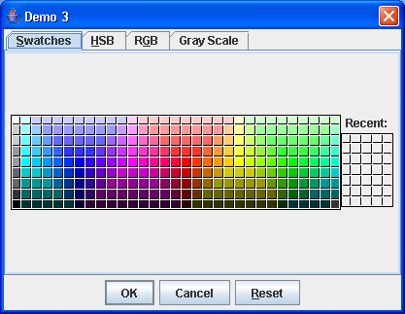
JColorChooser
Provides a GUI for navigating color spaces
Color c = JColorChooser.showDialog(Component parent, String title, Color initialColor)

Slide 32
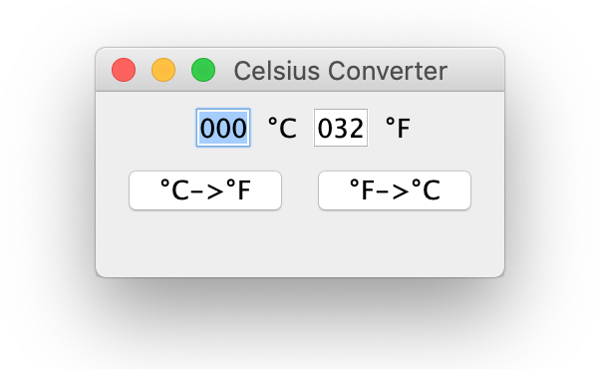
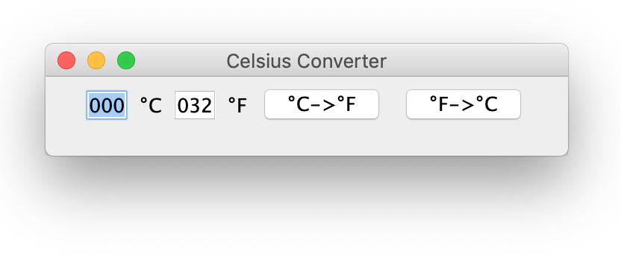
What is a layout?
Default GUIs, when resized, allow the automatic relocation of components:
this is a necessity: Java runs on many different platforms. Android Apps which are programmed in Java, for example, run on either 65” TVs or 6” smartphones (very different screen size!)

Slide 33
Layout Manager
A layout manager determines the disposal of the components in a container
Flow, Border, Grid, GridBag, Card Layouts
JPanels are containers supporting layouts
Different panels can have different layouts
Layout managers are passed to JPanel via the JPanel constructor
Methodology:
JPanel p = new JPanel(new GridLayout(2,2));
p.add(JButton);

Slide 34
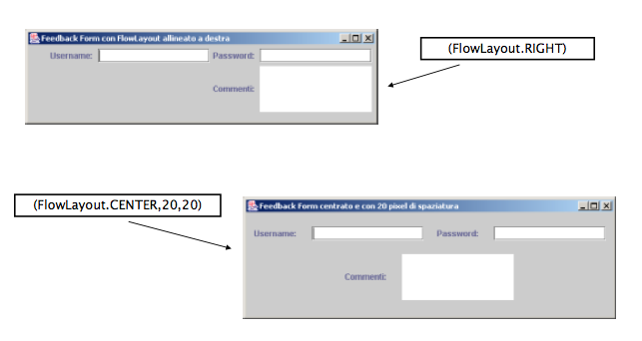
Layout Manager - FlowLayout

Slide 35
Layout Manager - FlowLayout
Default layout (i.e., new JPanel())
Disposes components from left to right
Constructors:
FlowLayout f = new FlowLayout();
FlowLayout f = new FlowLayout(int align);
FlowLayout f = new FlowLayout(int align, int hgap, int vgap);
Constructors parameters:
align: Alignment (FlowLayout.LEFT, FlowLayout.RIGHT, FlowLayout.CENTER)
hgap: Horizontal space between components (default: 3 pixel)
vgap: Vertical space between components (default: 3 pixel)

Slide 36
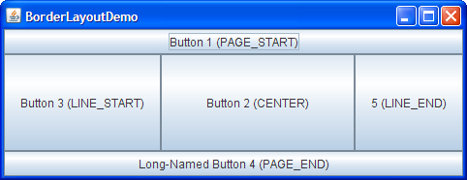
Layout Manager - BorderLayout

Slide 37
Layout Manager - BorderLayout
Splits a container into five areas (PAGE_START, PAGE_END, LINE_START, LINE_END, CENTER).
Constructors:
BorderLayout b = new BorderLayout();
BorderLayout b = new BorderLayout(int hgap, int vgap);
hgap, vgap are the spaces between the components related horizontal and vertical
The filling is “targeted”:
JPanel p = new JPanel(new BorderLayout()); p.add(BorderLayout.PAGE_START, new JButton());
p.add(BoarderLayout.PAGE_END, new JButton());

Slide 38
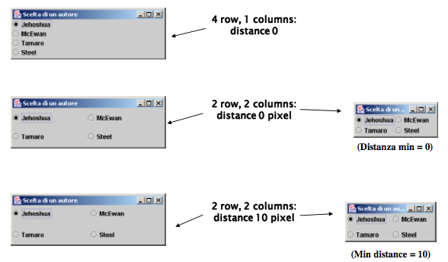
Layout Manager - GridLayout

Slide 39
Layout Manager - GridLayout
Splits the visual area in a grid of rows and columns
Starts filling from the top-left cell
Constructors:
GridLayout g = new GridLayout(int rows, int cols);
GridLayout g = new GridLayout(int rows, int cols, int hgap, int vgap);
Constructors parameters:
rows: number of row
cols: number of columns
hgap: Spacing (in pixels) between two horizontal boxes (default: 0 pixel)
vgap: spacing (in pixel) between two vertical boxes (default: 0 pixel)

Slide 40
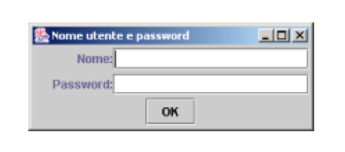
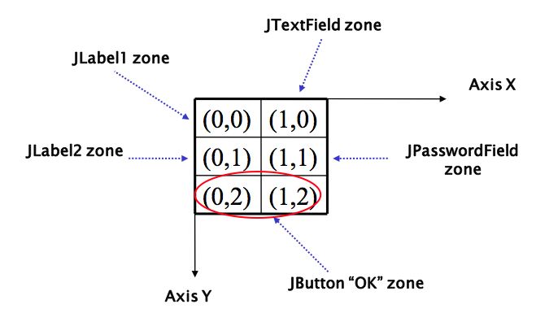
Layout Manager - GridBagLayout

Slide 41
Layout Manager - GridBagLayout
Extension of GridLayout. Makes it possible to adjust the elements of the grid
Methodology:
JPanel p = new JPanel(new GridBagLayout());
GridBagConstraints c = new GridBagConstraints();
//For each component to be added to this container:
//...Create the component...
//...Set instance variables in the GridBagConstraints instance...
p.add(theComponent, c);

Slide 42
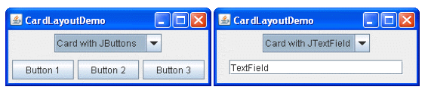
Layout Manager - CardLayout
CardLayout allows to have different panels in one frame, but only one showed at time
Panels are called cards
Methodology:
JPanel p = new JPanel(new CardLayout());
p.add(“Panel1”, new JPanel());
p.add(“Panel2”, new JPanel());

Slide 43
Java Swing Events
Università di Modena e Reggio Emilia
Prof. Nicola Bicocchi (nicola.bicocchi@unimore.it)

Slide 44
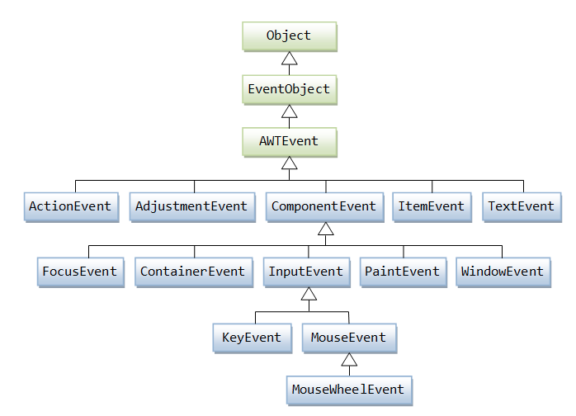
EventObject

Slide 45
Event Delegation Model
Events are classified by a subtype of AWTEvent
MouseEvent, KeyEvent, ActionEvent
Events are generated in components (source)
Listeners (target) can be registered to components
Whenever an event occurs, the event thread send a message to all the registered listeners (the event is passed to listeners as a parameter)
Listeners must implement appropriate interfaces to make the callback mechanism possible

Slide 46
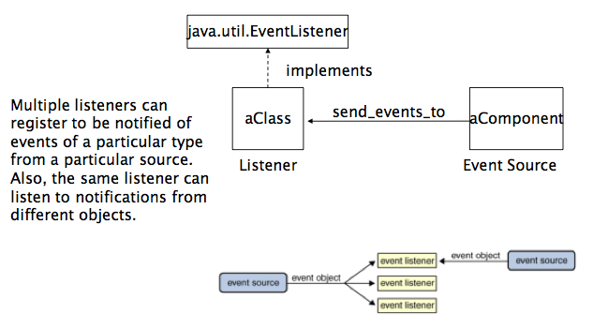
Event Delegation Model

Slide 47
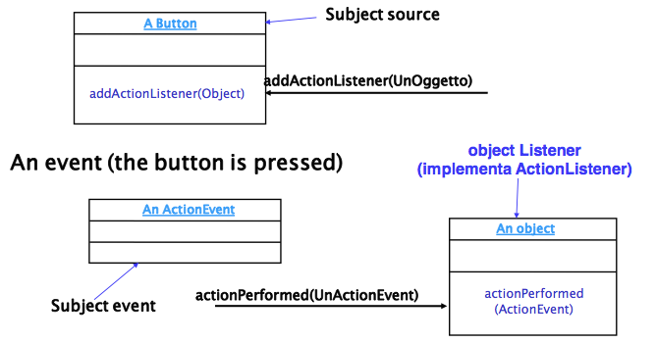
Example

Slide 48
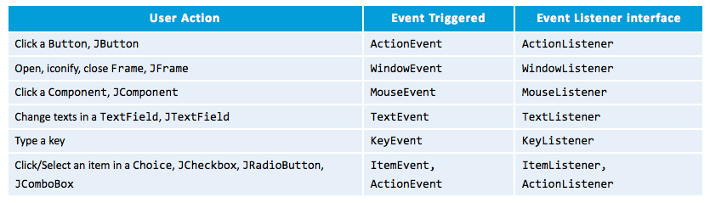
Event Delegation Model
Events are organized by type
Events need specific listener methods

Slide 49
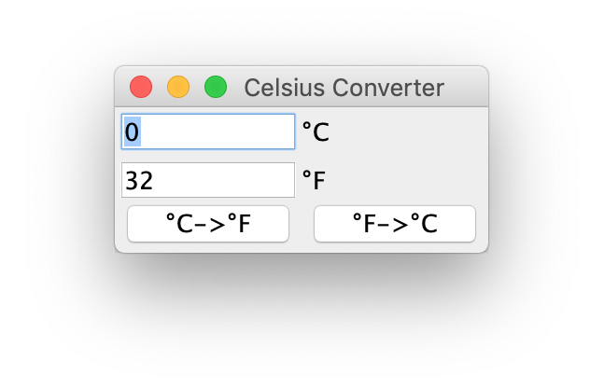
A complete example
public class CelsiusConverterFull extends JFrame implements ActionListener {
private JButton CFButton;
private JButton FCButton;
private JTextField fahrenheitTF;
private JTextField celsiusTF;
public CelsiusConverterFull() {
super("Celsius Converter");
celsiusTF = new JTextField("0");
fahrenheitTF = new JTextField("32");
CFButton = new JButton("°C->°F");
CFButton.addActionListener(this);
FCButton = new JButton("°F->°C");
FCButton.addActionListener(this);
JPanel p1 = new JPanel(new GridLayout(2, 2));
p1.add(celsiusTF); p1.add(new JLabel("°C"));
p1.add(fahrenheitTF); p1.add(new JLabel("°F"));
JPanel p2 = new JPanel(new GridLayout(1, 2));
p2.add(CFButton); p2.add(FCButton);
JPanel p3 = new JPanel(new BorderLayout());
p3.add(p1, BorderLayout.NORTH); p3.add(p2, BorderLayout.SOUTH);
setContentPane(p3);
setDefaultCloseOperation(WindowConstants.EXIT_ON_CLOSE);
setSize(200, 100);
setVisible(true);
}
}

Slide 50
A complete example
public void actionPerformed(ActionEvent e) {
if (e.getSource() == CFButton) {
int tempFahr = (int)((Double.parseDouble(celsiusTF.getText())) * 1.8 + 32);
fahrenheitTF.setText(Integer.toString(tempFahr));
}
if (e.getSource() == FCButton) {
int tempCelsius = (int)(((Double.parseDouble(fahrenheitTF.getText())) - 32) * 0.555);
celsiusTF.setText(Integer.toString(tempCelsius));
}
}
public static void main(String[] args) {
new CelsiusConverterFull();
}

Slide 51
How to manage events in Java
Events are managed similarly to exceptions:
sources of events (JButton, JTextField, etc..) select their receivers
Example: button.addActionListener(receiver)
receivers of events declare which events are able to deal with (one or more) by implementing the needed interfaces
Pay attention! Receivers implement interfaces, so they must implement all methods of those interfaces (see interface MouseListener)!

Slide 52
How to manage events in Java
Generally, JComponents can:
Handle events on their own
In case of large number of components
Delegate events to their container
In case of small/medium number of components
Delegate events to external classes
Rarely used (produces unneeded classes)

Slide 53
Handle events on their own
JButton btn = new JButton();
btn.addActionListener(new ActionListener() {
@Override
public void actionPerformed(ActionEvent e) {
// do something
}});

Slide 54
Delegate events to their container
class FrameWithEvents extends JFrame implements InterfaceWithEvents {
JComponent sourceofEvents = new JComponent();
sourceOfEvents.addListener(this);
void method1OfTheInterfaceWithEvents() {...}
void method2OfTheInterfaceWithEvents() {...}
void methodnOfTheInterfaceWithEvents() {...}
}

Slide 55
Delegate events to external classes
class MyListener implements InterfaceWithEvents {
void method1OfTheInterfaceWithEvents() {...}
void method2OfTheInterfaceWithEvents() {...}
} //end class
class Frame extends JFrame {
MyListener l = new MyListener();
JComponent sourceofEvents = new JComponent();
sourceOfEvents.addListener(l);
} //end class

Slide 56
Dealing with multiple sources
Frequently, multiple components register to the same listener. For example, a group of buttons within the same JFrame. It is needed a mechanism for recognizing the actual source of each event.
getSource() and object references
if (e.getSource() == buttonSelfDestruction ) {}
getActionCommand() and strings
If (e.getActionCommand() == “destroy”) {}
Event classes
If (e instanceof(KeyEvent)) {}

Slide 57
Event Interfaces
ActionListener
void actionPerformed (ActionEvent evt)
FocusListener
void focusGained (FocusEvent evt)
void focusLost (FocusEvent evt)
ItemListener
void itemStateChanged (ItemEvent evt)

Slide 58
Event Interfaces
MouseListener
void mouseClicked (MouseEvent evt)
void mouseEntered (MouseEvent evt)
void mouseExited (MouseEvent evt)
void mousePressed (MouseEvent evt)
void mouseReleased (MouseEvent evt)
MouseMotionListener
void mouseDragged (MouseEvent evt)
void mouseMoved (MouseEvent evt)

Slide 59
Event Interfaces
KeyListener
void keyPressed (KeyEvent evt)
void keyReleased(KeyEvent evt)
void keyTyped(KeyEvent evt)
WindowListener
void windowActivated(WindowEvent evt)
void windowClosed (WindowEvent evt)
void windowClosing (WindowEvent evt)
void windowDeactivated (WindowEvent evt)
void windowDeiconified (WindowEvent evt)
void windowIconified (WindowEvent evt)
void windowOpened (WindowEvent evt)

